Slide 1
Broad Trajectory Searches Using Monte Carlo Tree Search with the Inclusion of ΔVEGA Trajectories
AAS 20-686
Paper Link

Slide 2
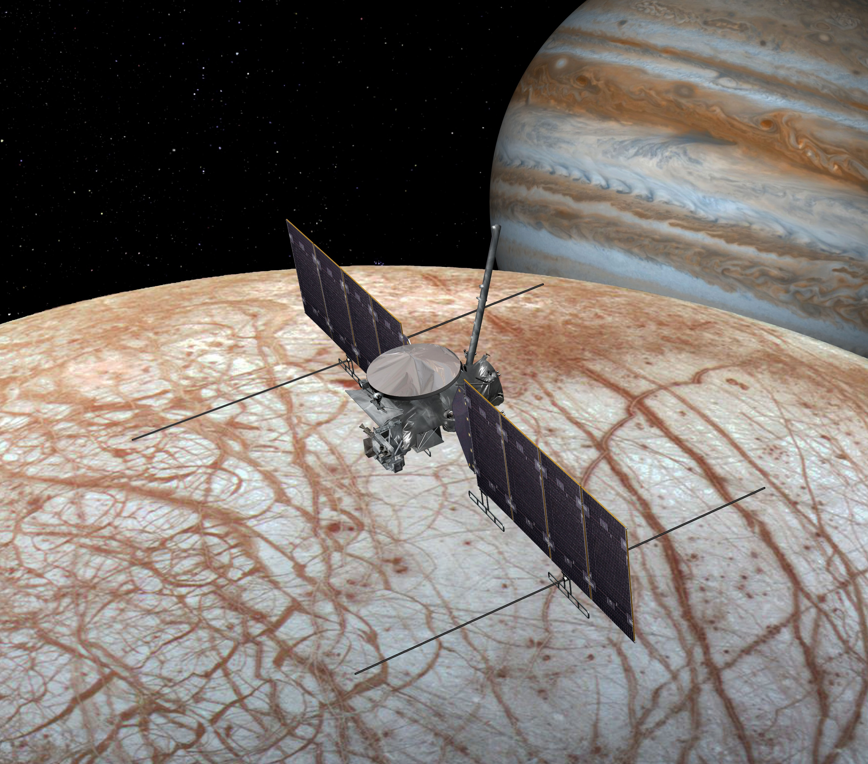
Introduction
Courtesy of JPL
Solution Space Complexity
With each additional flyby, another dimension is added to the solution space
Broad Search Role
Reduce solution space to only areas of interest
Solve for sequences with rough timings to be converged in later steps
Broad searches are one of the first steps in trajectory design, by creating regions of interest

Slide 3
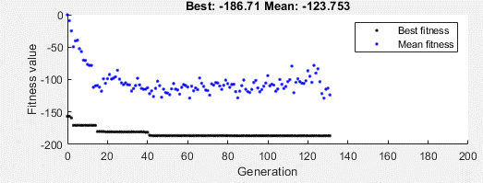
Previous Broad Search Algorithms
Evolutionary Algorithms
Improves ability to search after each generation
Examples:
Particle Swarm Optimization
Differential Evolution
Genetic Algorithms
Grid Search
Evenly Searches Solution Space
Examples:
Beam Search
Breadth-First Search
Depth-First Search
Lazy Race Tree Search
Courtesy of MATLAB
Genetic Algorithm Training
1.00
0.75
0.50
0.25
0.01
Grid Search Dispersion
Grid searches are computationally expensive, but using heuristics reduces the cost

Slide 4
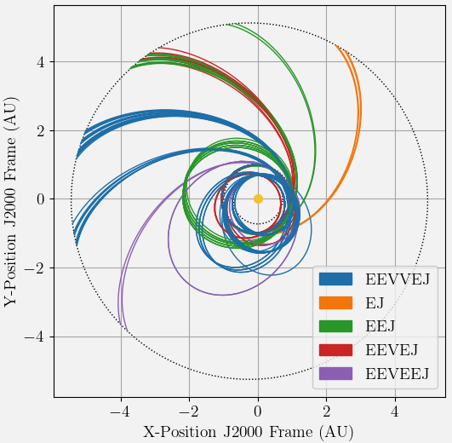
Objectives
Create a tool to find multi-flyby sequences given solution space
Rank solutions based off their viability for optimization
Include the option for a ΔVEGA orbit in the solution space
The inclusion of ΔVEGA orbits provides a diverse set of possible trajectories to explore

Slide 5
Intro to Monte Carlo Tree Searches (MCTS)
Used in competitive game AI (GO, Chess, etc.)
Each node, , is one possible state
Lines are transitions between states
Uses heuristics to narrow search options to optimal candidates
To Root
Parent Node
Branch
Leaf Node (No Children)
Current Node
Properties:
State
Reward
Visits
Constraints met?
MCTS works best in environments with random behavior and minimal observability

Slide 6
Application to Broach Trajectory Searches
Goal
Explore only the sequences that show promise while ignoring sequences that break constraints
Angular Grid
Angular grids patterns better suit orbit conics than Cartesian grid patterns
Node Properties
State: (Planetary NAIF ID, Encounter Epoch)
ΔV used to reach point in trajectory
Constraints
Flyby Altitude/Bending Angle
ΔV Budget
Maximum C3
Tree is built using a loop of four steps Selection → Expansion → Simulation → Backprop
Arrival Node
δ
Launch Node
Each node in a sequence is connected by a Lambert arc

Slide 7

Application to Broach Trajectory Searches
Paths down the tree to find leaf a node
Estimates value of node through UCB1 function: ^{[1]}
X: Future reward from child node
C_{p}: Exploration-Exploitation Parameter
n: Number of visits to current node
N: Number of visits to child node
Planetary State
Trajectory Leg
Root Node
$$\text{X}+C_{p}\sqrt{{\ln{n}}/N}$$
Launch Dates
1st Flyby Planet
Selection
Expansion
Simulation
Backprop
The C_{p} parameter was found to have the best results when set to 1/√2 ^{[1]}

Slide 8
Application to Broach Trajectory Searches
Creates a new layer of nodes to explore
Checks each child for feasibility
Calculates unoptimized ΔV using powered flyby assumption ^{[2]}
If node exceeds ΔV budget, it is made terminal,
Selects lowest ΔV child by convention
Planetary State
Trajectory Leg
Root Node
Launch Dates
1st Flyby Planet
2nd Flyby Planet
Selection
Expansion
Simulation
Backprop
Powered flyby approximations are used to mitigate the coarse nature of the grid search

Slide 9
Application to Broach Trajectory Searches
Run Monte Carlo simulations from leaf node to determine future reward, X
Takes random steps through possible decision and returns reward once terminal condition reached
Either the ΔV budget is exceeded or destination planet reached
Planetary State
Trajectory Leg
Root Node
Launch Dates
1st Flyby Planet
2nd Flyby Planet
X = n
Selection
Expansion
Simulation
Backprop
A small bonus is provided to simulations that terminate early, corresponding to depth

Slide 10
Application to Broach Trajectory Searches
Propagates simulated reward back through branch
New rewards are weighted against previously received rewards
Creates a more accurate picture of the branches as the tree builds
Planetary State
Trajectory Leg
Root Node
Launch Dates
1st Flyby Planet
2nd Flyby Planet
Selection
Expansion
Simulation
Backprop
At the end of backpropagation, the loop continues until the iteration budget is gone

Slide 11
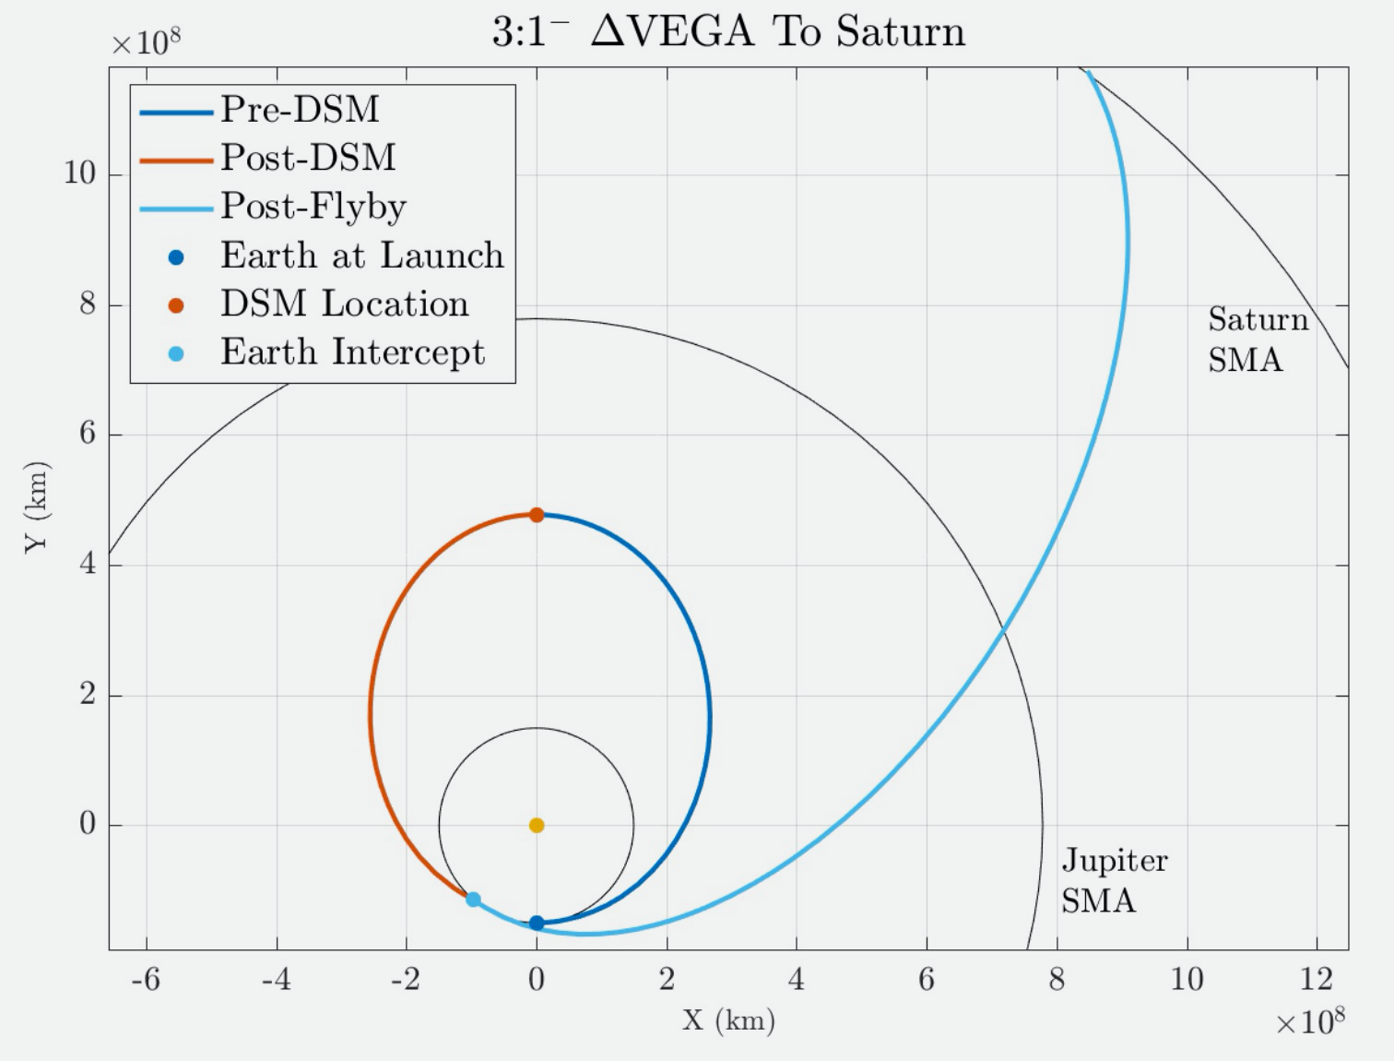
Implementation of ΔVEGA
k:1^{+/-} resonance of Earth (2, 3, and 4)
Pre-DSM orbit properties determined from k
Earth intercept point held fixed and a Lambert arc is used to determine DSM ΔV and EGA incoming relative velocity.
Minimizer used to reduce normal (in-plane) component of ΔV by adjusting the pre-DSM orbit.^{[3]}
Solutions stored in lookup table and evenly spaced set of MCTS nodes correspond to each k and intercept true anomaly.
A lookup table method prevents the need of calculating the DSM during the tree search.
This estimate serves as an initial condition for the optimization process.

Slide 12
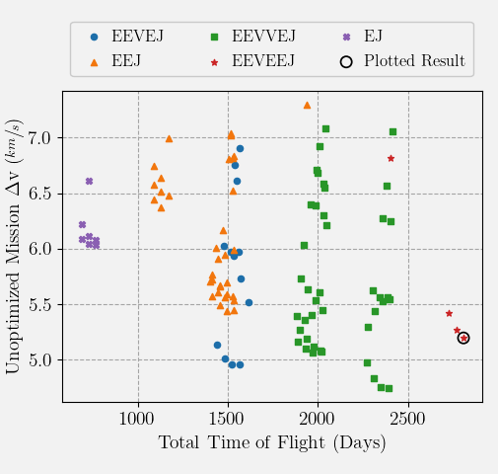
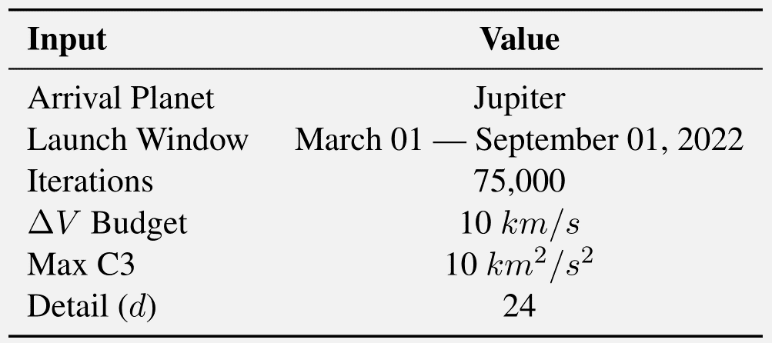
Europa Clipper (1/2)
Simulation Goal
Find EELV Europa Clipper trajectory (EEVEEJ) as described by Buffington^{[4]}
Assess algorithm’s ability to find long flyby sequences
Tree Search Inputs
After the run completed, the tree search found 275 trajectories from 1.9B possibilities

Slide 13
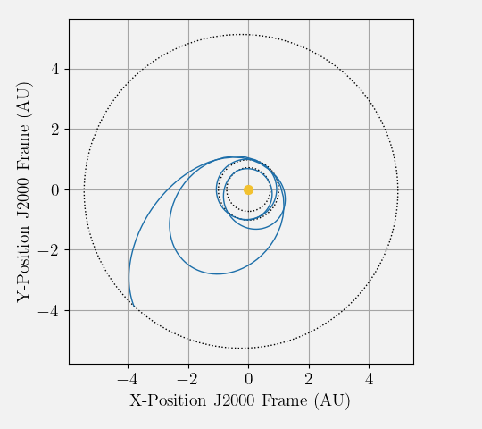
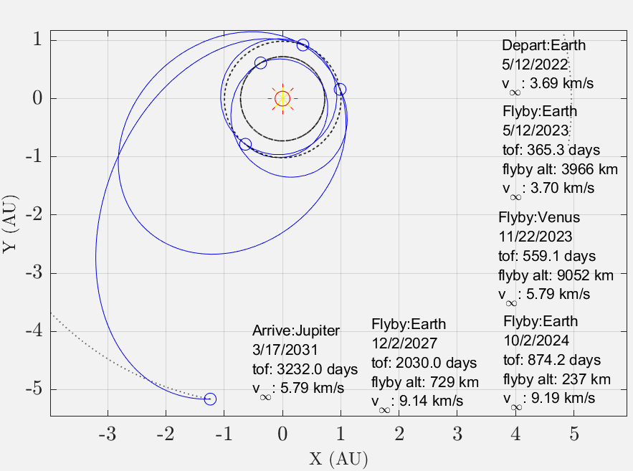
Europa Clipper (2/2)
The tree search results (left) are within 30 days of their optimized counterparts (right) excluding Jupiter encounter. This confirms the algorithm’s ability to find multi-flyby trajectories

Slide 14
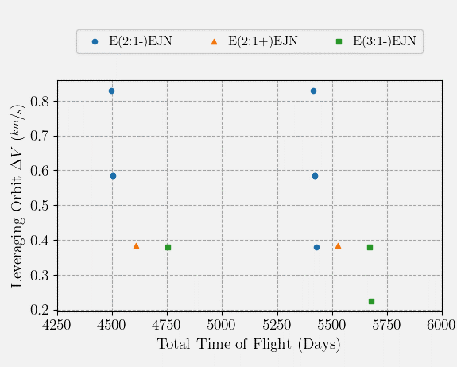
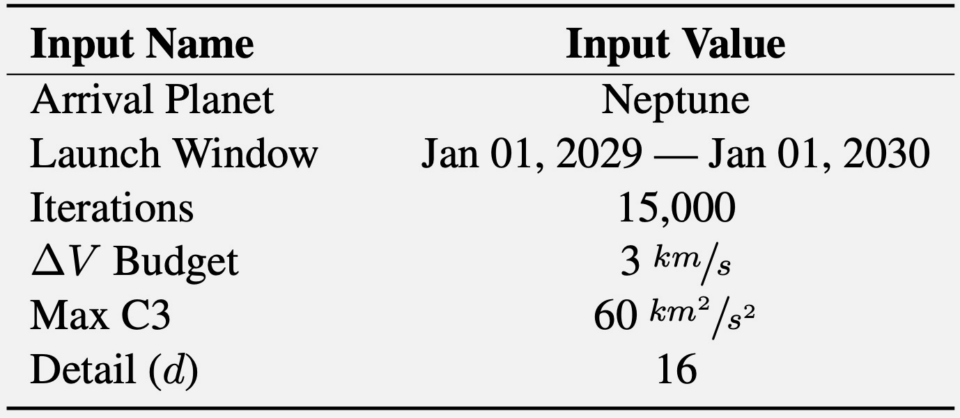
Trajectories to Neptune (1/2)
Simulation Goal
Find trajectories to Neptune via a JGA and Earth orbit leveraging
Test ΔVEGA trajectories and the predicted required DSM ΔV
Tree Search Inputs
Various ΔVEGA trajectory options exist for the EEJN search space.

Slide 15
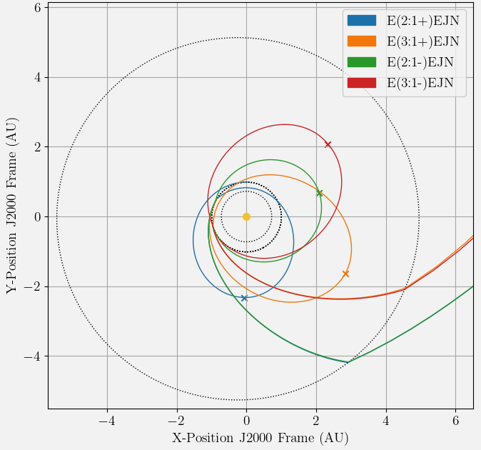
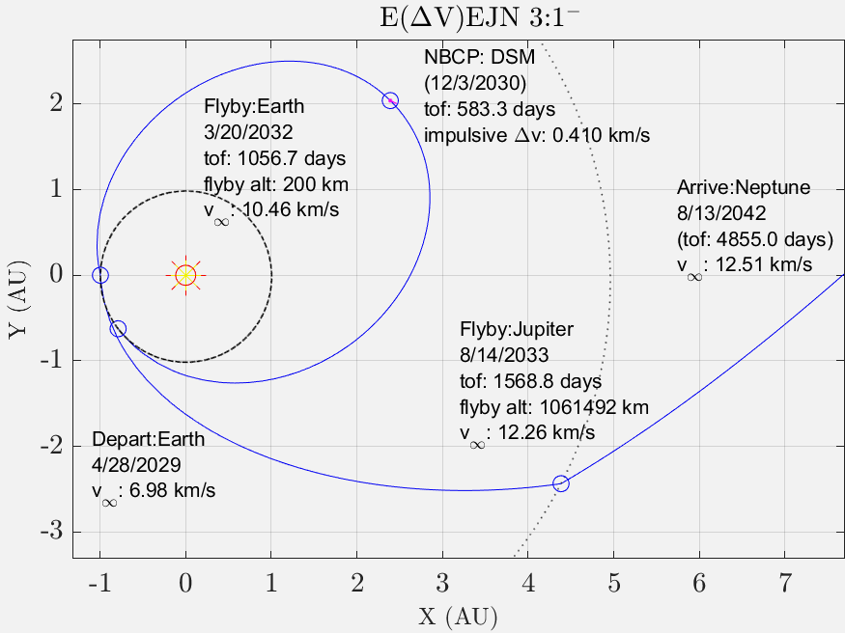
Trajectories to Neptune (2/2)
The MCTS results with Earth leveraging make for useful initial guesses for the optimizer, and the DSM ΔV estimate is <0.3 km/s of the predicted for all tested cases.

Slide 16
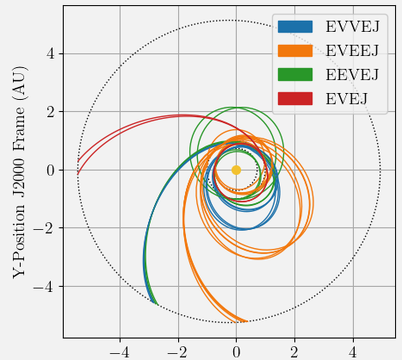
Conclusion
Created a multi-flyby broad search tool using MCTS
Good balance between exploration and exploitation of the search space
Implemented ΔVEGA orbit leveraging using a lookup table solution
Demonstrated algorithm’s capability to find multi-flyby sequences to Jupiter and Neptune
Future Work: V∞ leveraging of Venus, 3-D Flybys

Slide 17
For any questions regarding the paper
Please join Virtual Room Trajectory Design and Optimization IV on August 12, 2020 at 11:20 AM EST.
Thank you

Slide 18
References
[1] | D. Hennes and D. Izzo, “Interplanetary trajectory planning with Monte Carlo tree search,” IJCAI International Joint Conference on Artificial Intelligence, Vol. 2015-Janua, No. Ijcai, 2015, pp. 769–775.
[2] | S. Wagner and B. Wie, “Hybrid algorithm for multiple gravity-assist and impulsive Delta-V maneuvers,” Journal of Guidance, Control, and Dynamics, Vol. 38, No. 11, 2015, pp. 2096–2107, 10.2514/1.G000874.
[3] | A. Sims, Jon; Longuski, James; Staugler, “V(infinity) Leveraging for Interplanetary Missions Multiple-Revolutuion Orbit Techniques,” Journal of Guidance, Control, and Dynamics, Vol. 20, No. 3, 1997, pp. 409–415.
[4] | B. Buffington, “Trajectory design for the europa clipper mission concept,” AIAA/AAS Astrodynamics Specialist Conference 2014, 2014.

